Slide 1

Pitching: product’s idea

Slide 2
Educational course (Heading):
Market: Education.
The target audience: Students and parents.
This education course should help you get better grades, just like working as it can make your savings rise.
Product heading

Slide 3
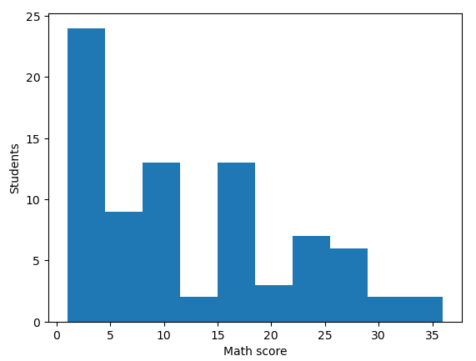
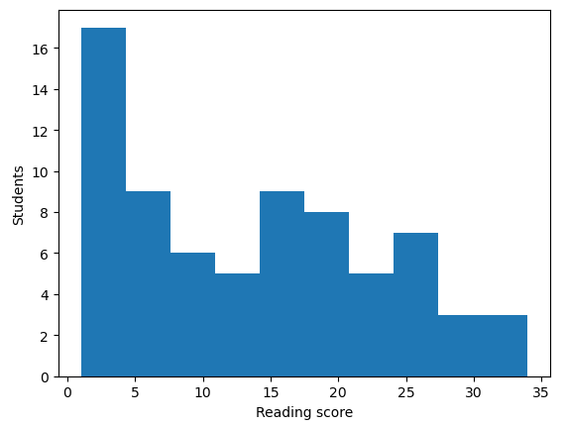
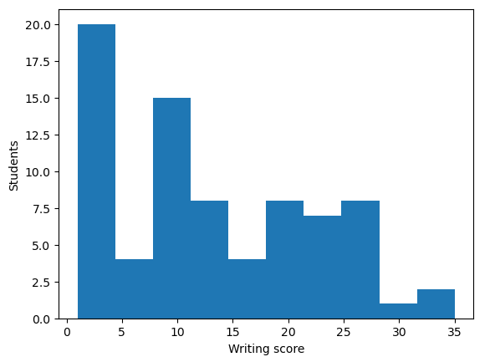
Heading (hypothesis № 1)
Diagram 1
Diagram 2
Diagram 3
Students' Math Grades
Students' Reading Grades
Students' Writing Grades
Graphs from product

Slide 4
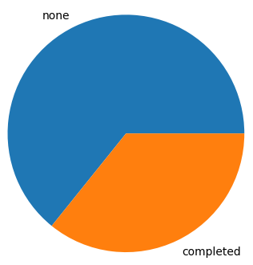
Heading (hypothesis № 2)
Diagram 1
Ratio of students that finished the course and students that didn’t
Graphs from product

Slide 5
Sum of what you learned from graphs
A lot of students got good grades in math.
A lot of students got good grades in reading.
A lot of students got good grades in writing.
The amount of students that completed the course is only a little more than a quarter of all students in the course.
Sum

